Slide 1
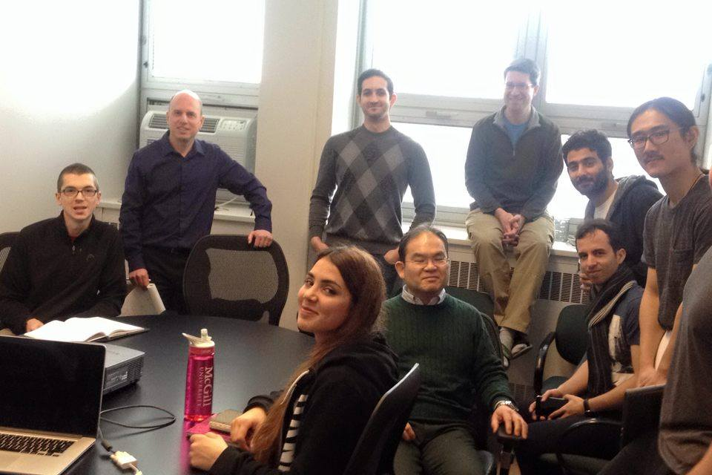
Notes:
We start off with a simple image, for example of the grouphere

Slide 2
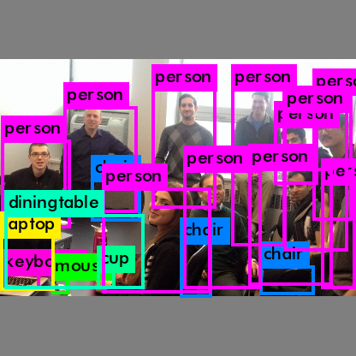
Notes:
And run it through one of the models and get this output

Slide 3
Image Captioning
Honors Thesis ECSE 499
Sharhad Bashar | Roger Girgis
Supervisor: Prof. Jeremy Cooperstock
Notes:
My thesis

Slide 4
Agenda
Autour
Objective
Background
Current Progress
Future Plans
Notes:
What the presentation covers

Slide 5

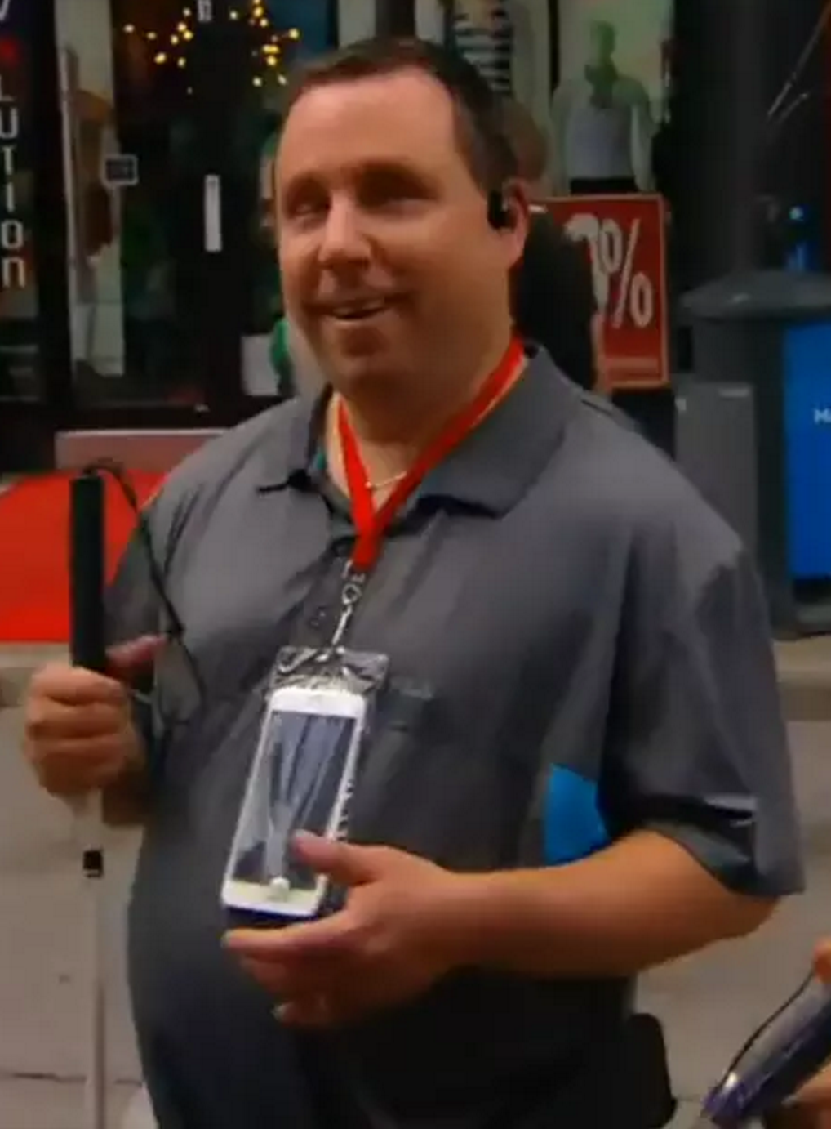
Eyes free system
An app
Built in sensors
Notes:
Autour is an eyes free mobile system that is designed to help the visually impaired to get a better understanding of their surroundings.
It is a download able app, that uses the built in sensors of a phone, such as cameras to reveal information and directions to the users.
These details are relayed to the user through audio, in the similar way a sign or visual cues would to a sighted user.
This picture shows a user wearing his cell phone around his neck. It is using the front facing camera, and the gps to reveal things around the user.
It also provides more in depth information about a particular location, on request

Slide 6
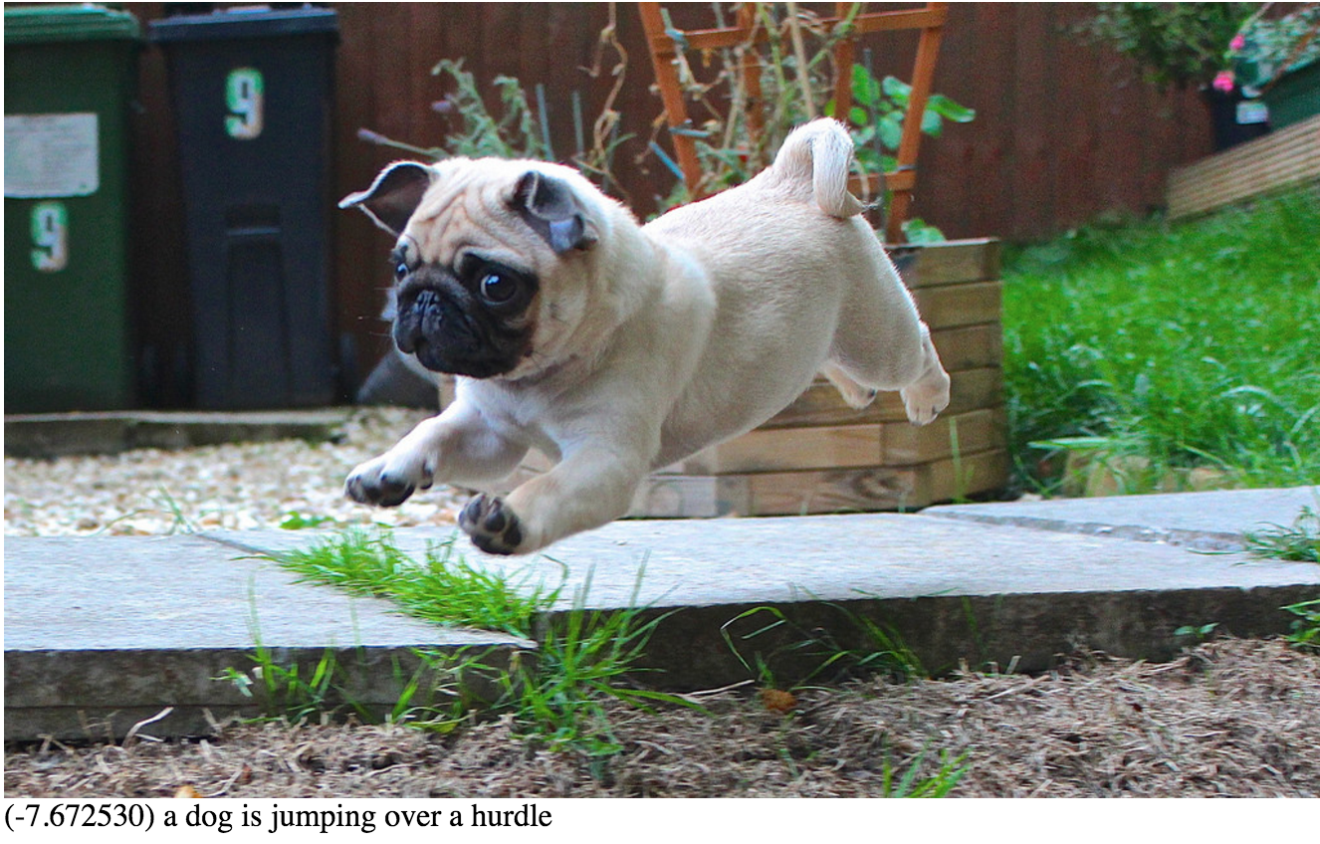
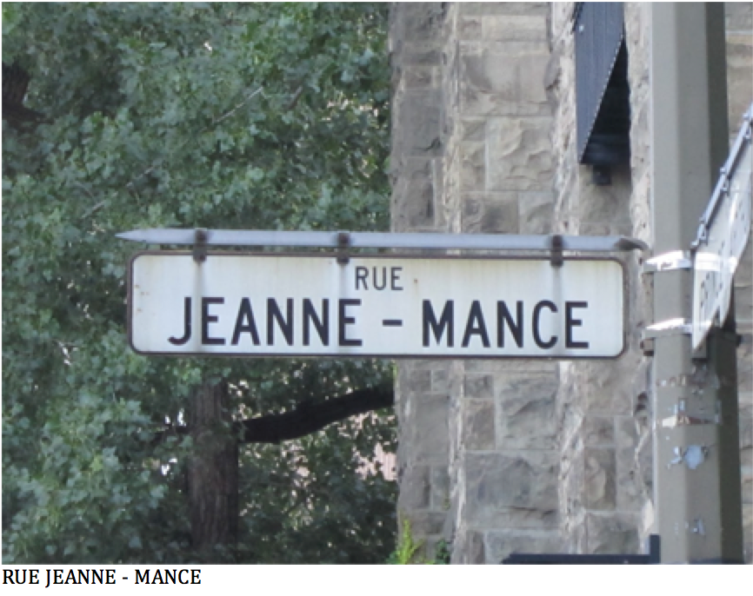
Objective
Image captioning system
Deep learning
Notes:
The purpose of this project is to built an image captioning for Autour
The users camera will take pictures at a certain time interval, and the image will be uploaded to cloud, where a computer will access the images, run it through a
Deep Learning Network, and produce a sentence, describing the objects in the image.
So what is an image made of?
It is usually made of objects such as animals, humans, cars and etc.
And it has actions that link the object to the image. For example, this image of a dog, which is jumping over a hurdle.
A model will be created, and trained with image data bases, such as MSCOCO.
We will be feeding images to the model, and the model will generate such description of the objects and actions in the image
Item like signs and labels will also be read to the user, for example street post picture of Jeanne Mance Street, and the caption reads out the sign

Slide 7
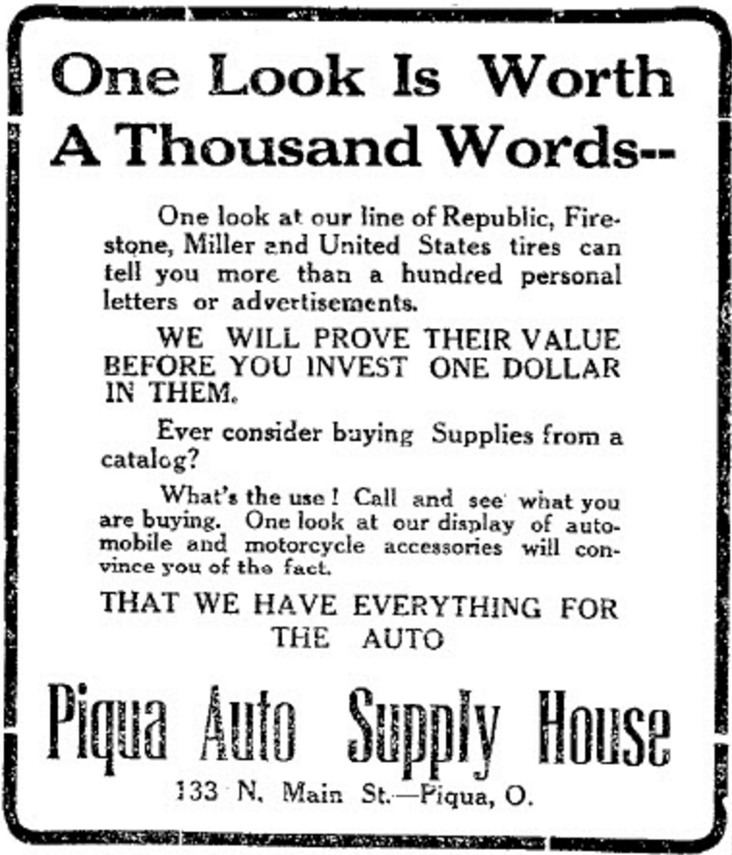
Background
The PASCAL Visual Classes (VOC)
The ImageNet Large Scale Visual Recognition Challenge (ILSVCR)
Notes:
For humans, it is easy to look at an image, and recognize the different objects and actions taking place in the image.
Not only can we recognize, but our brains can create complex sentences that can describe every single detail in an image giving a literal meaning to the quote “a picture tells a thousand words”
An interesting fact about that quote, it was originally created as a way to tell shoppers that you can look at a catalog and see all the items for sale
Through my research, I have come across two benchmarks in this subject:
The Pascal Visual Object Classes
The ImageNet Large Scale Visual Recognition Challenge (ILSVCR)
These are conferences that have been running annually since 2005, and they are two goals:
1) To create a dataset of images and their corresponding descriptions
2) To provide an annual competition for anyone to test out new algorithms or models.
There has been some great outcomes from these annual meetings, and each year they improve. Unfortunately, there isn’t time to talk about all of them
In the past few years, a quantifiable amount of work has been in the subject of Neural networks, and using them to classify, identify and describe images.
One of the most promising ones we have come across is NeuralTalk

Slide 8
Current Progress
Captioning
Text detection
Cross checking
Object detection
Color detection
Notes:
These are the four areas ill be talking about:

Slide 9
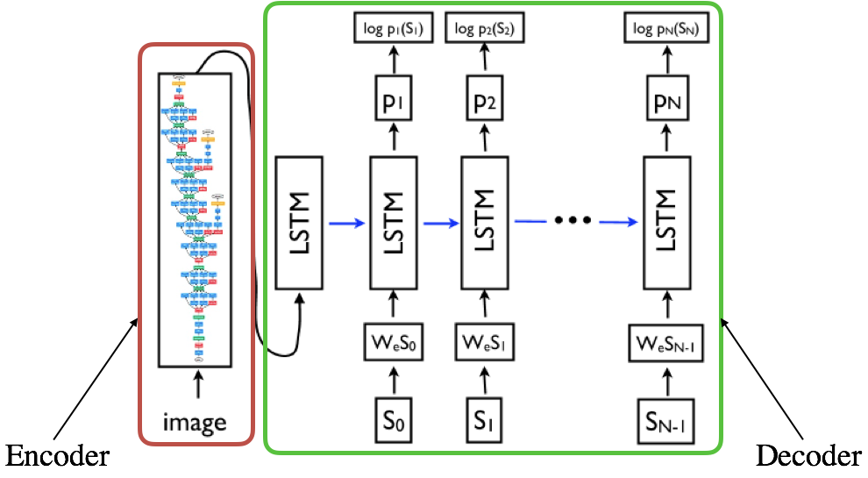
Image Captioning
Notes:
So, the architecture of the captioning system has two parts:
The first part is the encoder, which takes the image as an input
The model is trained to take an image I, and maximize the probability p(S|I)
Where S = {S1,S2,…,Sn} is a list of words from a dictionary that describe the image adequetely

Slide 10
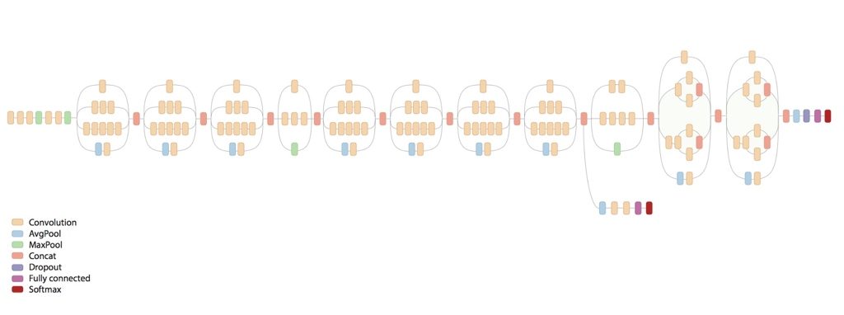
Encoder
Inception V3 Network
Notes:
The encoder is a 48 layer CNN that

Slide 11
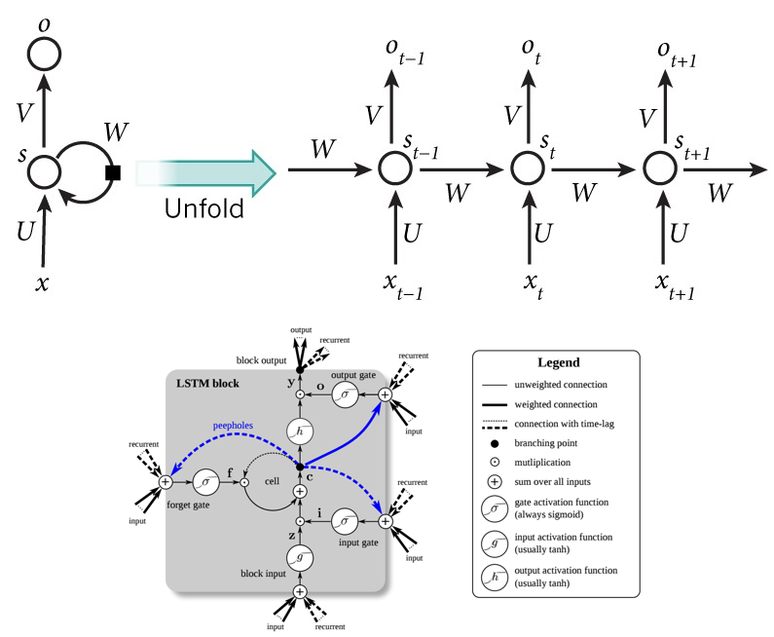
Decoder
Notes:
The RNN takes the vector of features as its input, and uses that to generate a list of words that best describe the image
LSTM is used to keep the weights generated for a much

Slide 12
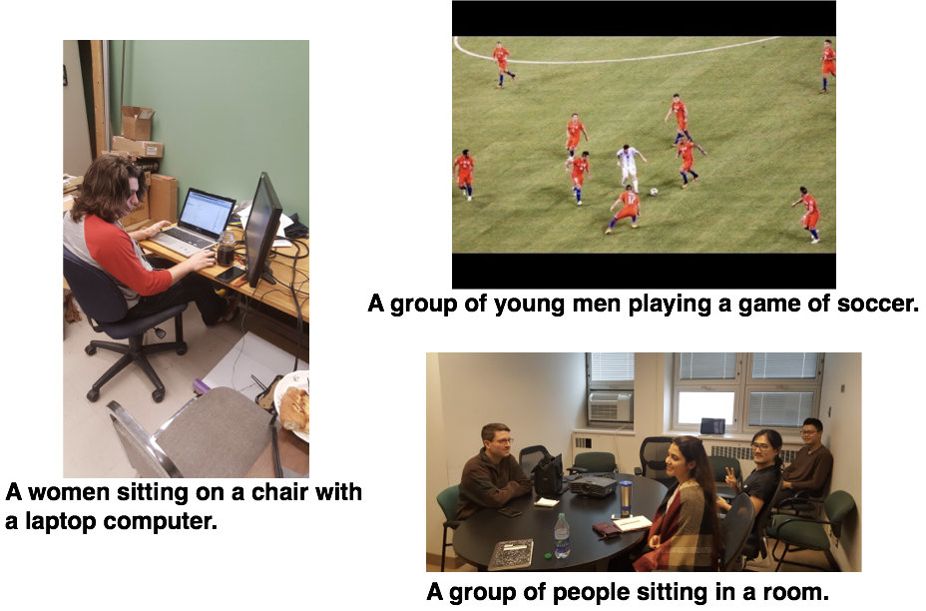
Results

Slide 13
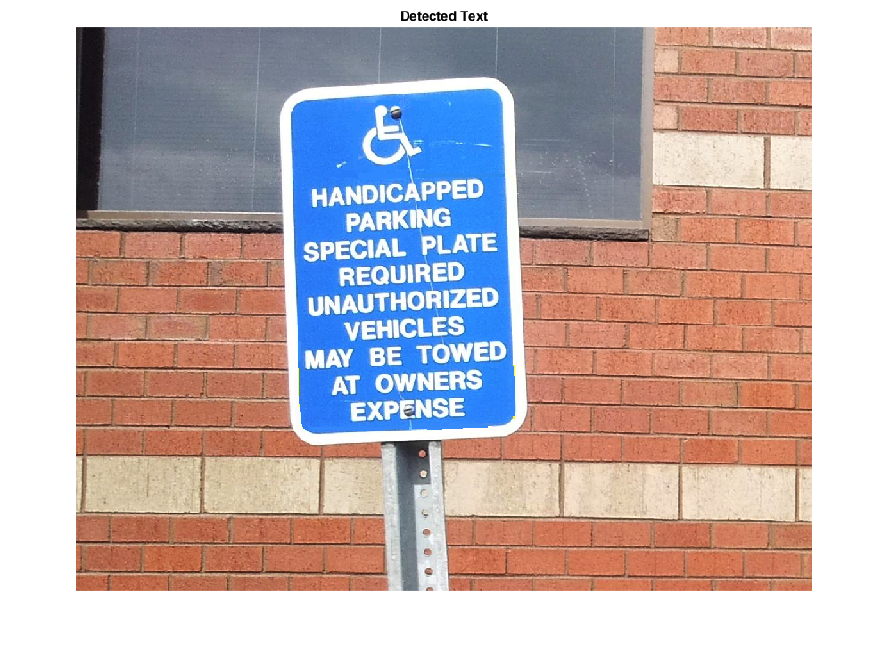
Text Recognition
Notes:
Moving on to Test recognition using OCR

Slide 14
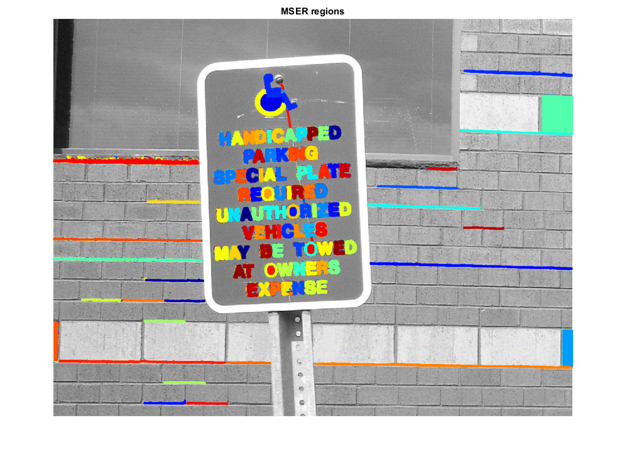
Maximally Stable External Regions
Notes:
Apply MSER on the image.
MSER regions are connected areas characterizedby almost uniform intensity, surrounded by contrastingbackground

Slide 15
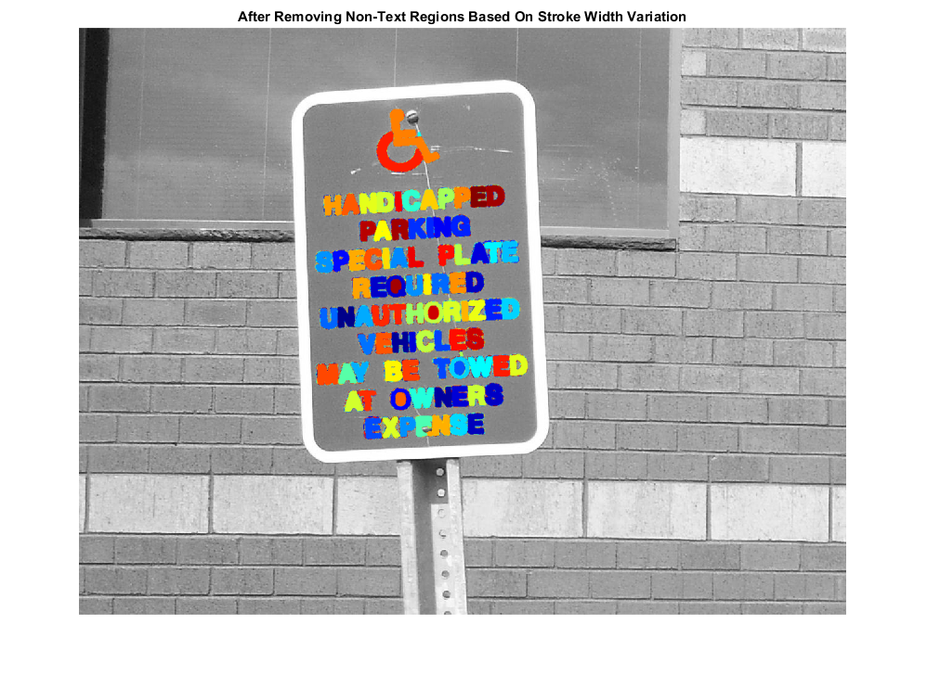
Remove non text region
Notes:
Once we have the MSER regions, we also get a few other regions in the image that are not text.
Using geometric properties of text, we remove the non text areas.
We can also train a NN to classify between text and non text

Slide 16
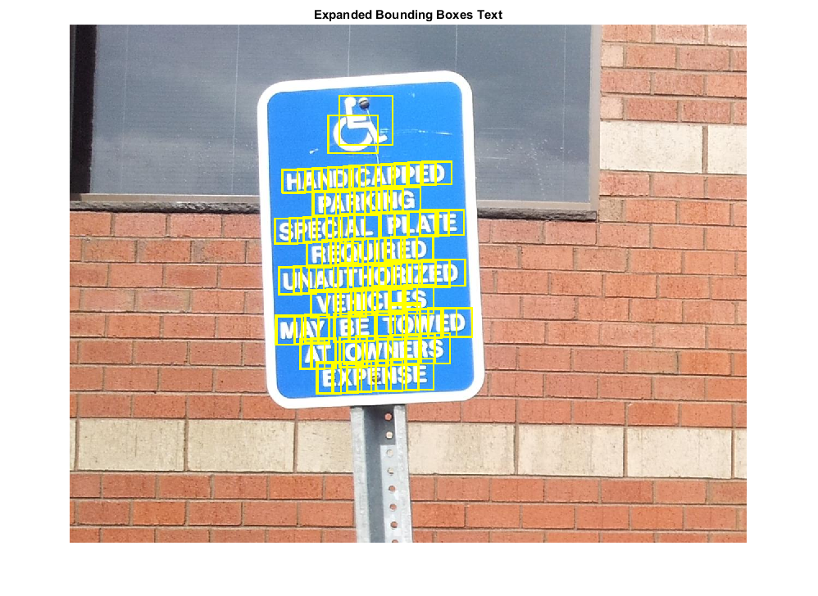
Bounding boxes
Notes:
After the letters and numbers are identified, we create bounding boxes around each of them
At this point, we can perform OCR on the image, but we will get a list of letters, and they might not be in the proper order, so might not make sense.
For example, the word PLATE, if we perform OCR on it at this point, we might get a list of letters in the right order that spell out PLATE, but chances are that we will get a list of words that don’t make sense,
for example : “LTAPE

Slide 17
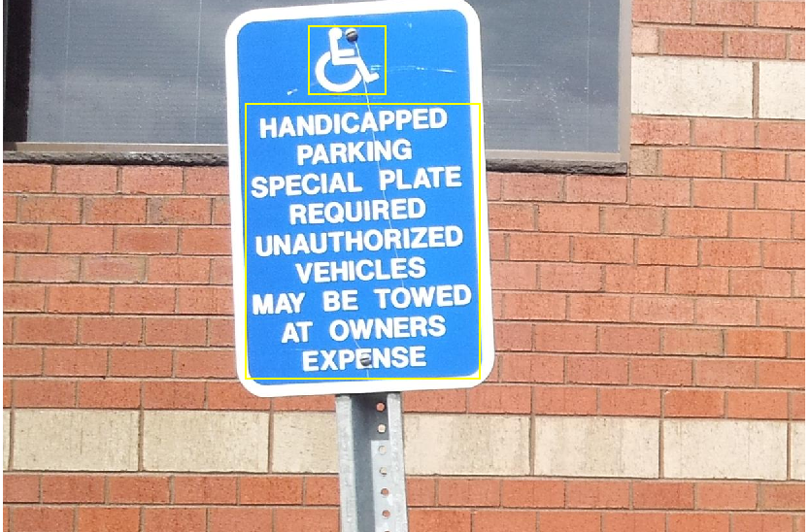
Combination and OCR
Notes:
So what we do is combine the overlapping bounding boxes, and this gives us a bigger bounding box.
We now perform OCR on the bounding boxes, and this gives us a results of what the text is

Slide 18
Result
HANDICIXPPED
PARKING
SPECIAL PLATE
REQUIRED
UNAUTHORIZED
VEHICLES
MAY BE TOWED
AT OWNERS
EXPENSE
Notes:
Here is the result
As you can see, some words weren't correctly spelled, for example HANDICAPPED
This depends highly on the quality and size of the image

Slide 19
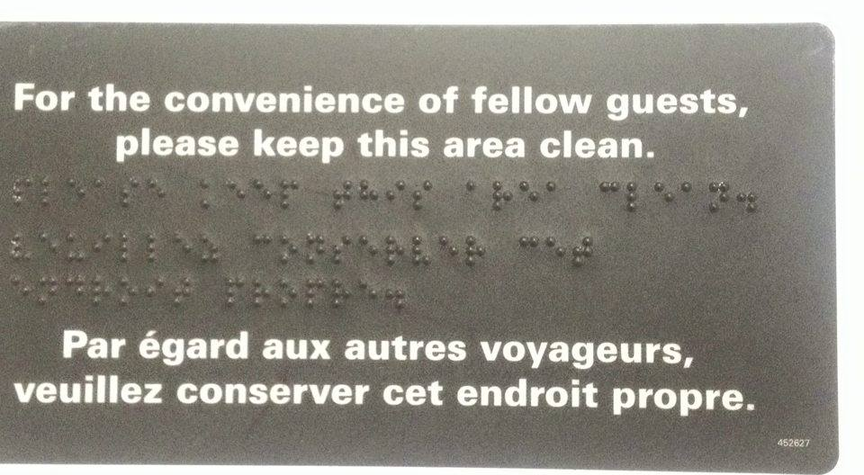
Result
For the convenience of fellow guests,
please keep this area clean.
Par yard aux autres voyageurs,
veuillez conserver cet endroit propre.
Notes:
This example here is a picture from a washroom on a train, and as we can see, the result is almost accurate

Slide 20
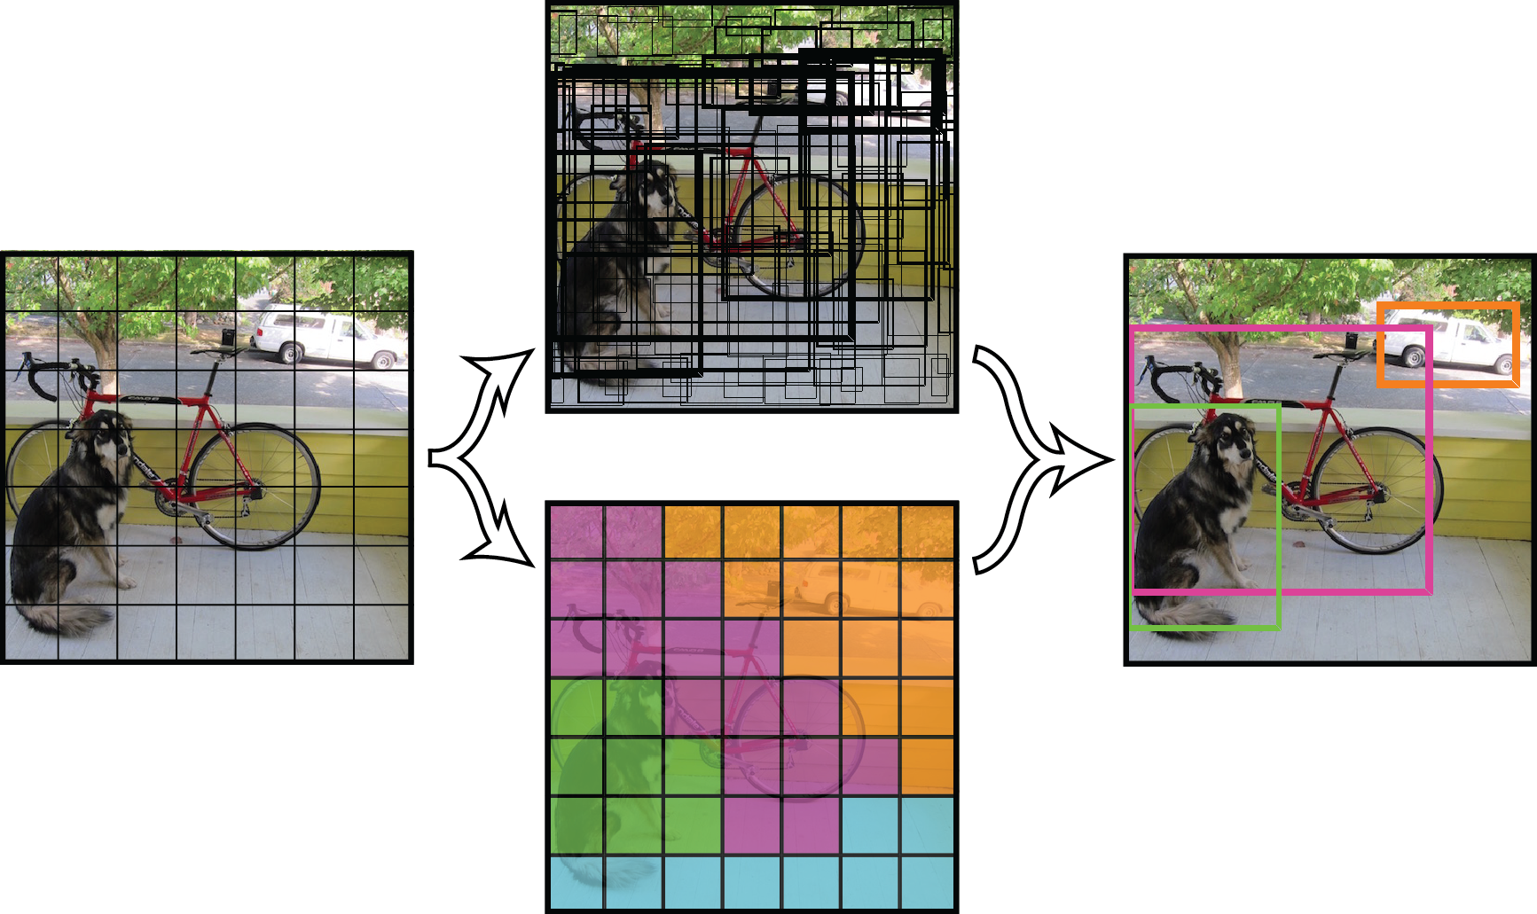
Object detection
Notes:
You start out with an image
Break it up into squares
And then create bounding boxes. These are done using a CNN, and edge detection.
Basically, all the little boxes create a bounding box, and run image classification on the bounding boxes. This returns with a score of how confident the box is that it recognizes the object.
All bounding boxes with the same classified image, and then boxed together
First you overlay a grid on top of that image, and each cell is responsible for detecting certain things
Each cell performs image classification, and returns a result of what it thinks its in the box, as well as a confidence value for that image

Slide 21
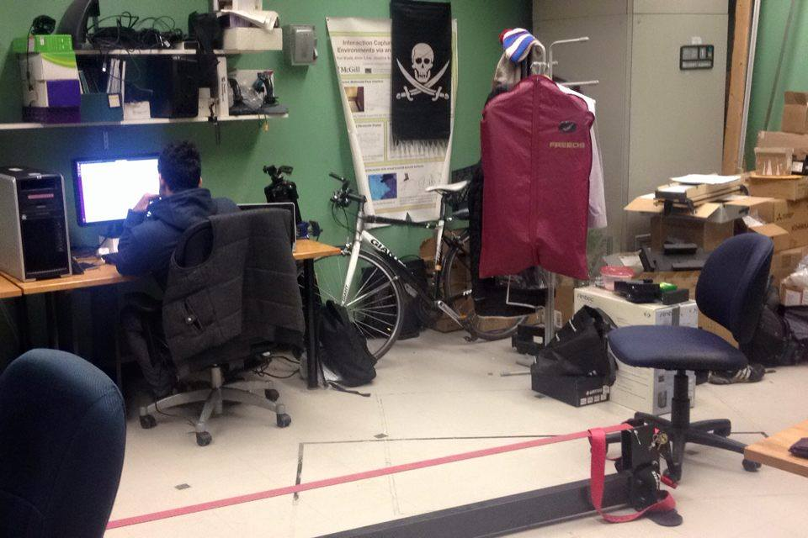

Slide 22
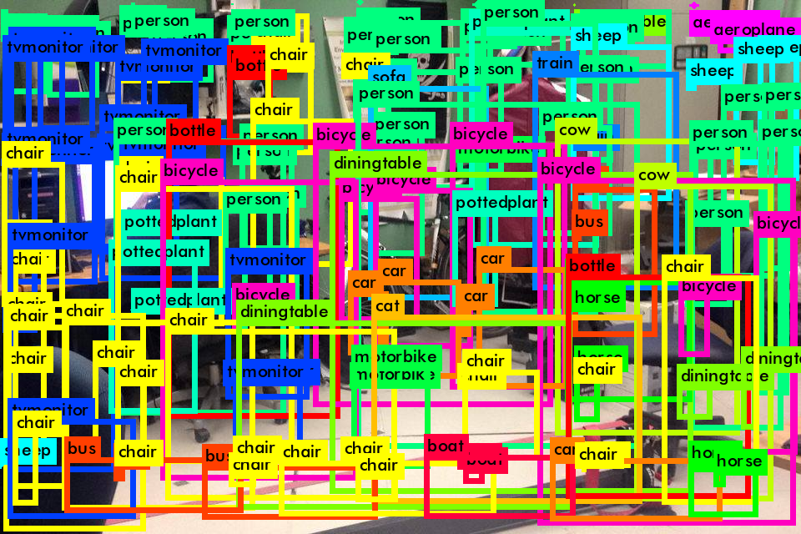

Slide 23
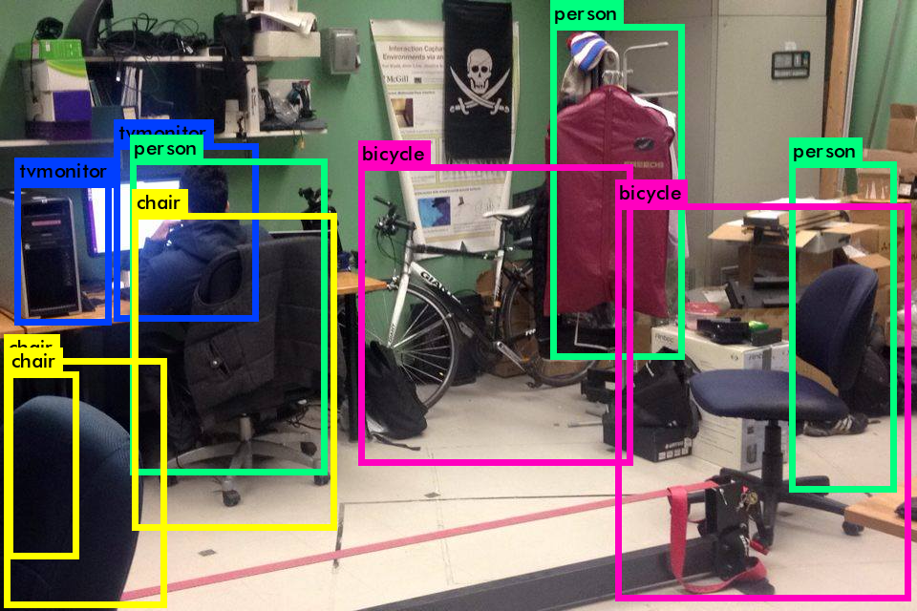

Slide 24

Color Detection
‘blue’
‘green’
‘black’
‘grey’
‘white’
‘red’
‘yellow’

Slide 25
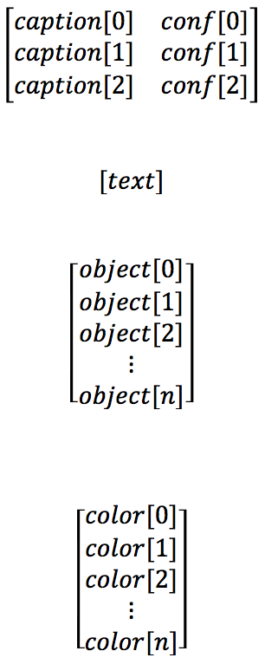
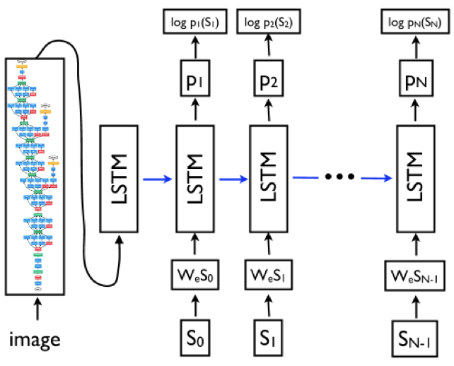
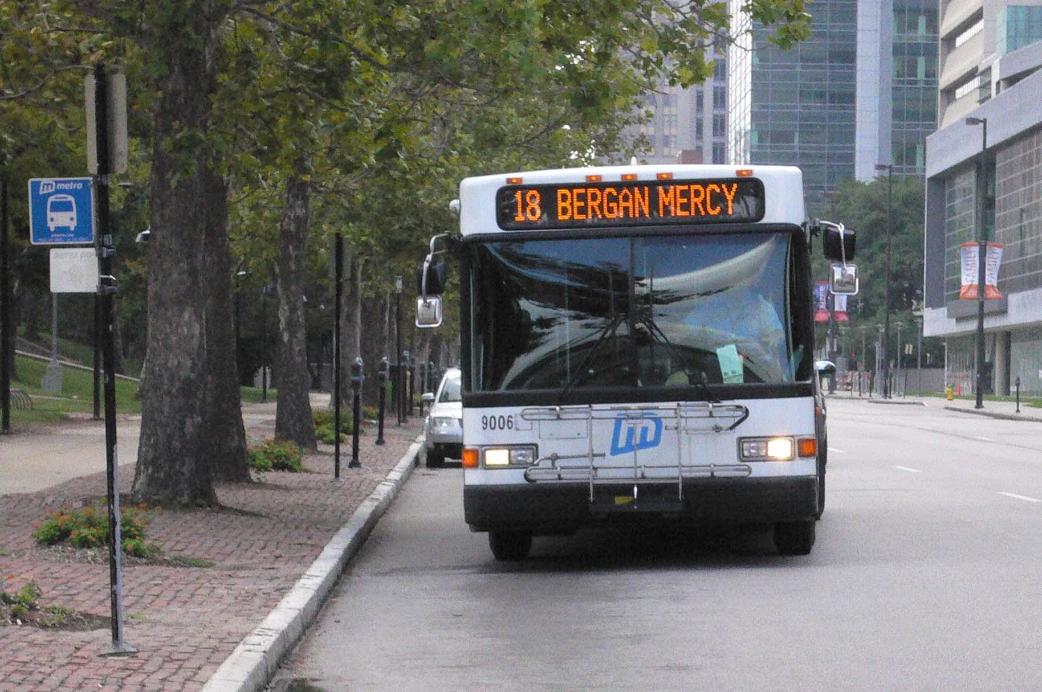
Final Caption
Cross Check
Notes:
High Level arcitecture

Slide 26
Test Image

Slide 27
1. Captions
Captions for image bus.jpg:
0) a white bus driving down a street next to tall buildings . (p=0.000771)
1) a white bus driving down a street next to a tall building . (p=0.000699)
2) a white bus driving down a street next to a building . (p=0.000367)

Slide 28
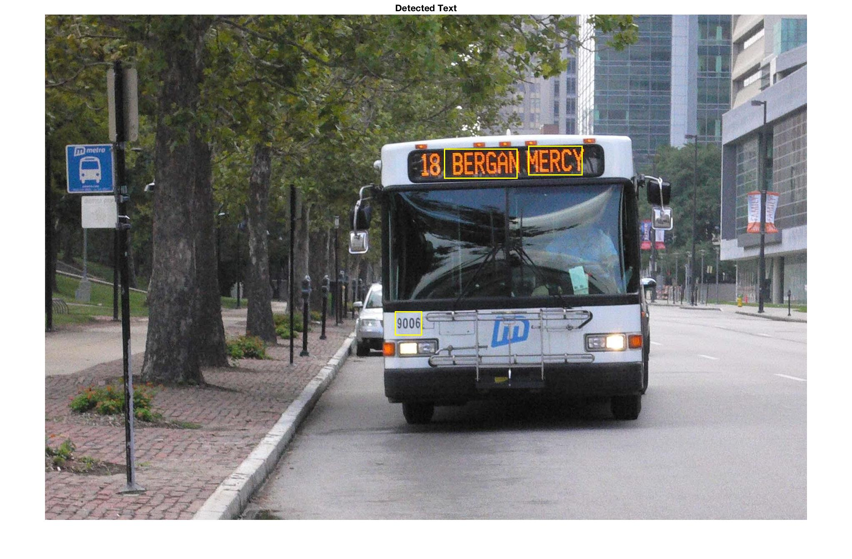
2. Text Detection
Text reads: MERCY BERGAN

Slide 29
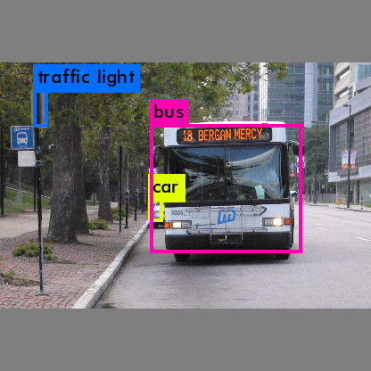
3. Object Detection
Objects:
Car
Bus
Traffic Light
Synonyms:
Vehicle
Wagon
Van
Auto
Ride

Slide 30
4. Color Detection
Blue
Grey
Brown
Green
White

Slide 31
Cross Checking
0) a white bus driving down a street next to tall buildings . (p=0.000771)
1) a white bus driving down a street next to a tall building . (p=0.000699)
2) a white bus driving down a street next to a building . (p=0.000367)
Remove caption[2]
caption[0] has 2 matches (1 color, 1 object)
caption[1] has 2 matches (1 color, 1 object)
Pick caption[0] for most matches and higher confidence score

Slide 32
Final Output
A white bus driving down a street next to tall buildings
Text reads: MERCY BERGAN

Slide 33
Thank You!
Notes:
Slide reviews
Highlight stats
----- Meeting Notes (17-03-28 12:03) -----
what was my work and what was done
what was new presented
autor backgroud and need what i did
go easier on deep learning

